Slide 1
Improve Your Profitability with Integrated Business Intelligence
Jeff Gunderson, xTuple Midwest USA
Wednesday, October 15, 2014

Slide 2
Competitive Advantage of BI
Visualizations are key to understanding.
Measures are critical to evaluating & improving performance.
But greatest benefit is leading you to new questions and new understandings.

Slide 3

BI Success
Easy to use
Fast
Integrated with ERP
Self Service
Cloud option

Slide 4

Terrific Retro Toys
Terrific Retro Toys

Slide 5



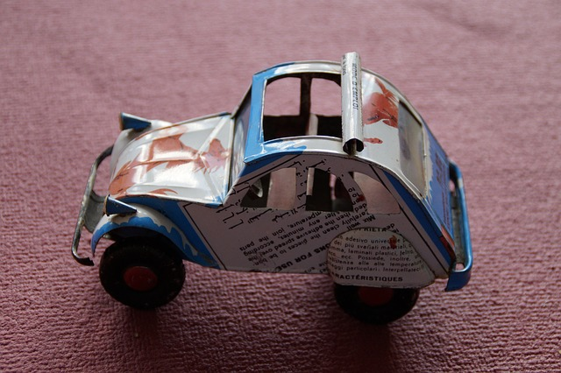
TRT Products

Slide 6
TRT 2014 Performace Goals
Opportunities
Increase opportunities, document losses.
Improve conversion to sales.
Sales
Increase sale of manufactured products.
Profitability
Reduce investment in low profit regions
Cash Flow
Improve efficency of order fullfillment

Slide 7
How TRT Measured Last Year
Custom reports requested for each performance goal
But goals kept changing.
IT folks always had higher priority.
Trends reviewed by extracting and Excel magic
Only one Excel wiz.
Data was always to late to take action.
Couldn’t understand data behind the charts.

Slide 8
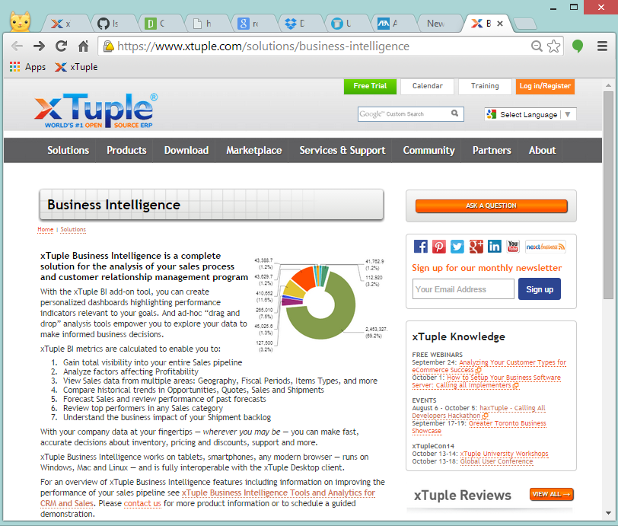
xTuple BI
Notes:
But this year we are using xTuple wiht integrated Business Intelligence.

Slide 9

The Team
Sam Masters, Sales Manager
How does the opportunity volume compare to last year? And the forecast?
Is our sales velocity improving? (days to complete opportunities)
Is our conversion ratio improving? (ratio of opportunities to sales)

Slide 10

The Team
John Smith, NA Sales
What are John’s top opportunities and outstanding quotes?
How do John’s sales compare to last year?
Who are John’s top customers?
Is John selling more manufactured products.
Notes:
For incentives, add sales booking counts with filter for John Smith and manufacturing.

Slide 11

The Team
Ira Watcher, CFO
Profitability by product line.
Sales by geography
Efficiency in order fulfillment

Slide 12

TRT Performance Improvement
Visualizations
Relevant
Relate to operational data
Measure progress
Timely
Goal driven
Self service
Adjust goals
Explore new questions.
Larry W. Smith/European Pressphoto Agency

Slide 13
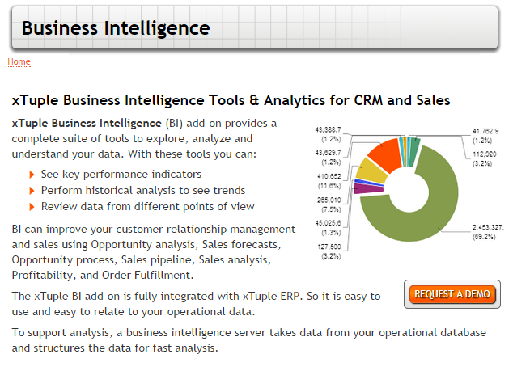
xTuple BI
www.xtuple.com/business-intelligence

